Slide 1
Under Water

Slide 2
Sonar Effect
Steps:
Find sonar Projection Point
Find Distance in each Fragment
Glow Fragment Pixel if Distance from Projection Point match Elapsed Time https://www.shadertoy.com/view/Wlj3DW
Check Reflection of Projection Point to Camera across Fragment Normal
Reduce Glow when Reflection isn’t direct
(Bonus) reflect the initial raycase and do a second weaker ping off of the next colli`ssion
Notes:
https://www.shadertoy.com/view/WtSGDD

Slide 3
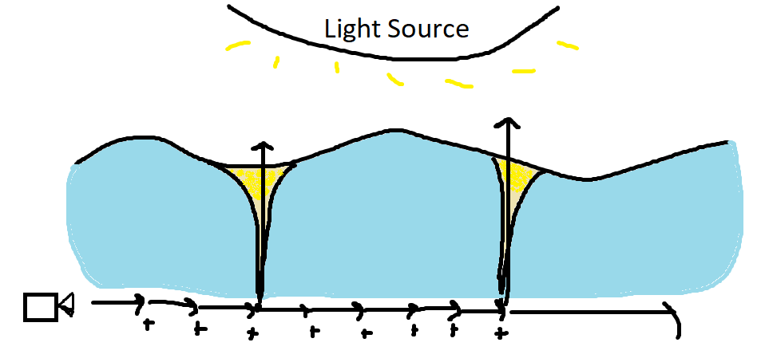
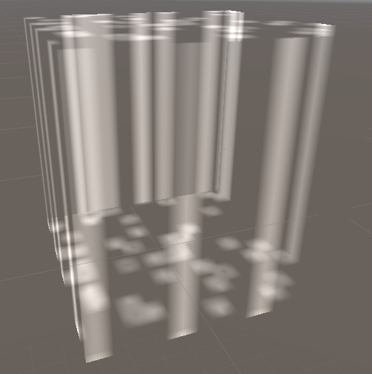
Light Ray Defusion
Desired Result
Use Ray Marching
Attempt One (Incomplete)

Slide 4
Wobbling Screen
Steps:
Grab screen texture
Apply the distortion texture over the screen texture and tile it
Move the pixels of the texture either left or right depending on the intensity value given through the inspector
Blend pixel offset
Grab the Camera ScreenMaterial
Apply the distorted texture over the screen material in OnRenderImage

